Slide 1
PLANNING INFORMATION SYSTEMS

Slide 2
PLANNING INFORMATION SYSTEMS
An Information System plan is a statement of how management foresees its ISs in the future.
An Information System plan includes:
Activities planner believes will help achieve goals.
Program for monitoring real-world progress.
Means for implementing changes in the plan.
Approaches to Planning
Nolan Stages of IT Growth
Critical Success Factors- Executives define critical success factors first so planning can address resources to support those factors. Critical success factor: issues identified as critically important to business success
Competitive Forces Model
Value Chain Analysis
Internet Value Matrix
Linkage Analysis Planning

Slide 3
IS PLANNING
IS planning process:
a process of developing and maintaining consistency between the organisation's objective and resources and its changing opportunities
Aims to define and document an approach top doing business that leads to satisfactory profits and growth
General direction for use and management of resources
Converts vision and mission into concrete achievables
Mission – about stating the purpose while vision is about stating the imagined future

Slide 4
IS PLANNING
Key elements of an IS Plan
Corporate mission statement
IS mission
Vision for IT within organization
IS strategic and tactical plans
Operations plan to achieve mission and vision
Budget to ensure resources are available

Slide 5
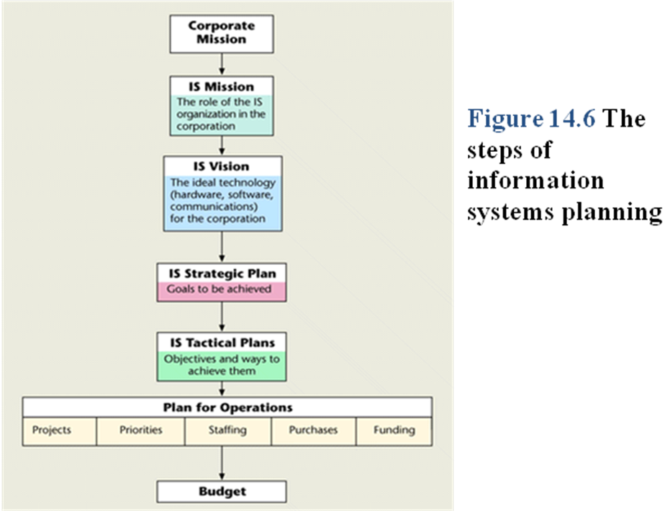
MODEL OF IS PLANNING

Slide 6
COMPONENTS OF THE IS PLAN
1. Establish a mission statement
These are the services that you are responsible for; it is your place in the organization
It is not what you are supposed to achieve, it is who you are and what you do in the company
The corporate mission statement details the purpose of the organization and its overall goals.
IS mission statement outlines the purpose of ISs in the organization.
A good mission statement will contain the following:
Elicits an emotional, motivational response
Is easily understood and can be transferred into individual action
Has a measurable, attainable goal
Is three to four sentences long
Is simple, honest and frank
Is fully believed

Slide 7
COMPONENTS OF THE IS PLAN
2. The IT Vision
Wish list of what IS managers would like to see in terms of hardware, software, and communications, to contribute to goals of the organization
Assess the environment
The capabilities of the IT department
The readiness of the company to use IT
The status of our customers, our industry
The status of the economy, government regulations, environment, society, etc.
Technology

Slide 8
COMPONENTS OF THE IS PLAN
3. Strategic and Tactical IS Planning- Set goals and objectives
IS strategic plan details what is to be achieved(Goals)
Set goals – what do you want to achieve?
IS tactical plan describes how goals will be met and by when (objectives)
Set objectives – what are your specific, measurable targets?

Slide 9
COMPONENTS OF THE IS PLAN
4. Derive strategies and policies
Strategies
Technology focus
Personnel and career development
Aligning with the company.
Policies for
Funding criteria, Allocation criteria; priority setting, Use of outside IT services, outsourcing

Slide 10
COMPONENTS OF THE IS PLAN
5. Develop long-, medium-, and short-range plans
Short-range – the next year, the next budget period; developing and operating current systems
Medium-range – committing to development efforts for applications that will take more than one year to complete;
Long-range planning – preparing for management’s future information needs.
6. Implement plans and monitor results
Different strategies can be applied for the implementation process. Monitoring of results is a continuous process until the users gain some trust on the system.
Use Balanced score card to evaluate financial and non financial

Slide 11
BALANCED SCORE CARD
A balanced scorecard is a performance metric used to identify, improve, and control a business's various functions and resulting outcomes.
BSCs were originally developed for for-profit companies but were later adapted for use by nonprofits and government agencies.
It is meant to measure the intellectual capital of a company, such as training, skills, knowledge, and any other proprietary information that gives it a competitive advantage in the market.
The balanced scorecard involves measuring four main aspects of a business: Learning and growth, business processes, customers, and finance.
BSCs allow companies to pool information in a single report, to provide information into service and quality in addition to financial performance, and to help improve efficiencies.

Slide 12
BALANCED SCORE CARD
Characteristics of the Balanced Scorecard Model (BSC)
Learning and growth
These are analyzed through the investigation of training and knowledge resources.
This first leg handles how well information is captured and how effectively employees use that information to convert it to a competitive advantage within the industry.
Business processes
These are evaluated by investigating how well products are manufactured.
Operational management is analyzed to track any gaps, delays, bottlenecks, shortages, or waste.

Slide 13
BALANCED SCORE CARD
Customer perspectives
These are collected to gauge customer satisfaction with the quality, price, and availability of products or services. Customers provide feedback about their satisfaction with current products.
Financial data
Financial data such as sales, expenditures, and income are used to understand financial performance.
These financial metrics may include dollar amounts, financial ratios, budget variances, or income targets.

Slide 14
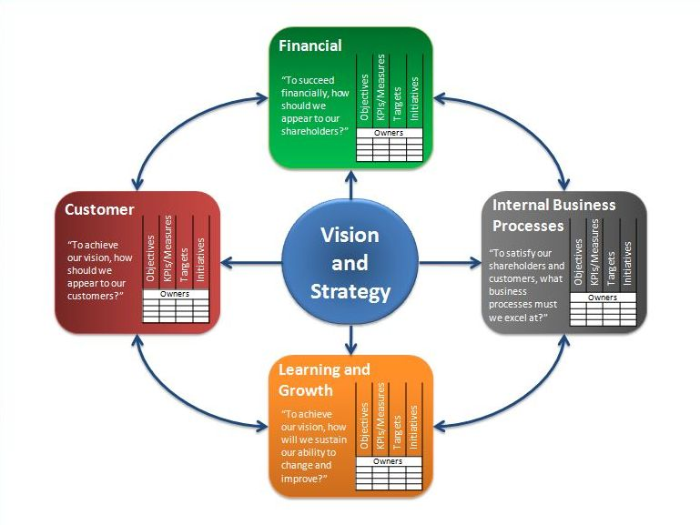

Slide 15
BSC ADVANTAGES
1. Better Strategic Planning
The business model is visualized in a Strategy Map which helps managers to think about cause-and-effect relationships between the different strategic objectives.
2. Improved Strategy Communication & Execution
BSC allows companies to easily communicate strategy internally and externally. It facilitates the understanding of the strategy and helps to engage staff and external stakeholders in the delivery and review of the strategy.
3. Better Alignment of Projects and Initiatives
The Balanced Scorecard help organisations map their projects and initiatives to the different strategic objectives, which in turn ensures that the projects and initiatives are tightly focused on delivering the most strategic objectives.

Slide 16
BSC ADVANTAGES
4. Better Management Information
The Balanced Scorecard approach helps organizations design key performance indicators for their various strategic objectives. i.e. higher quality management information and better decision-making.
5. Improved Performance Reporting
The Balanced Scorecard can be used to guide the design of performance reports and dashboards.
This ensures that the management reporting focuses on the most important strategic issues and helps companies monitor the execution of their plan.

Slide 17
.6. Better Organizational Alignment
The Balanced Scorecard enables companies to better align their organizational structure with the strategic objectives.
In order to execute a plan well, organizations need to ensure that all business units and support functions are working towards the same goals.
7. Better Process Alignment
Well implemented Balanced Scorecards also help to align organizational processes such as budgeting, risk management and analytics with the strategic priorities. This will help to create a truly strategy focused organization.

Slide 18
IS Planning Difficulties
Business goals and systems plans need to align
Rapidly changing technology-Technological advances, obsolete technology
Companies need portfolios rather than projects
Infrastructure development is difficult to fund
Responsibility needs to be joint, CIO, CEO, CFO, COO input is needed

Slide 19
VISION AND MISSION
Vision statement
The word vision means the conception of an image. In a vision statement you say where it is you want to go.
Quantifiable, Mental image

Slide 20
VISION AND MISSION
Mission statement
The Mission Statement flows directly from the vision statement. It is the implementation of the vision and it outlines what must happen to realize the vision.
It’s a “how-we-will-get-there” guide that contains action words and adjectives that modify them.

Slide 21
Organizational goals and objectives
Goals can shape everything an organization does from day to day. E.g. aiming for “good customer service” means people need to do specific things to head for the overall goal.
Objectives are specific, measurable, and achievable.
You can objectively say, “Yes – we definitely achieved that objective” (or not)
Objective (adjective) = fact-based
Subjective (adjective) = opinion-based)

Slide 22
Organizational goals and objectives
To achieve a goal, several specific objectives are created.
GENERAL GOAL: To provide good customer service.
SPECIFIC OBJECTIVES:
To answer all customer emails within 24 hours.
To reduce customer complaints by 10% this year.
To get at least 90% satisfaction on the next customer survey.
Organizations have goals that the entire organization aims to achieve. Typical examples are:
Profit (for commercial organizations)
Good customer service
Good communications with staff and customers
Efficient work practices
Good reputation

Slide 23
Organizational goals and objectives
Goals cont’d
Good decision-making practices
Protection of data
Good staff morale
Quality products
Cheap but reliable products
Such goals often serve to define the nature of each organization.

Slide 24
Organizational goals and objectives
FOR ANY ORGANISATION:
Efficiency: Every organization wants to be efficient: they don't want to waste time, money or effort.
Good decision making: Every organization wants to make informed and wise decisions to help them achieve their organization goals.
Effectiveness. Every organization wants to do their work well. How well they are prepared to do it, of course, will be affected by organizational goals.
Good reputation: Every organization wants to be regarded as competent in whatever they do, whether it is quality, price, speed or any other factor. Reputation is a very important asset.
Good customer service: Delivering products and services promptly, educating customer and after sale support

Slide 25
Organizational goals and objectives
How information systems can help achieve organizational goals
Simplify complex tasks (no experts, consultants needed)
Make tasks quicker to perform (efficiency gain)
Fewer errors so quality improves (effectiveness)
Time needed to fix errors is reduced (efficiency).
Output is better quality
Improve communication and collaboration with email, chat etc
Better decision making with management support tools
Frees people from tedious jobs - do better things
Allow the use of virtual teams

Slide 26
Information systems planning methodologies
Nolan identifies six stages of evolution of information tech­nology in a business enterprise. The stages are:
(a) Initiation
(b) Expansion
(c) Control
(d) Integration
(e) Data administration
(f) Maturity

Slide 27
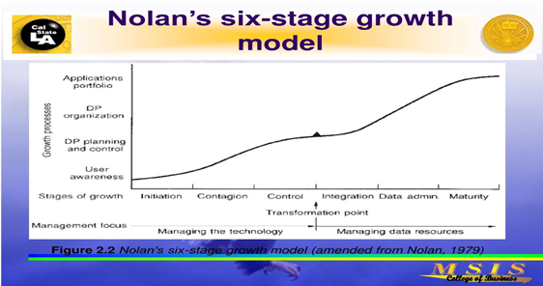
Nolan Six Stage IT Growth Model

Slide 28
Nolan Six Stage IT Growth Model
1. Initiation:
This is the first stage of evolution of information technology in an enterprise. During this stage, an enterprise acquires a few computer systems and application software packages. A select enthusiasts in the enterprise familiarize themselves with the com­puter systems and whatever software is available.
There is a high degree of de-centralization as IT professionals are busy developing new and basic applications. Since most of the modern enterprises of medium to large size are already using computer systems, this stage is a history for them as they have already passed through that stage.

Slide 29
Nolan Six Stage IT Growth Model
2. Expansion:
The second stage is that of expansion. During this stage, the information systems have found acceptability and every depart­ment is in the process of acquiring more information technology (IT) resources, as they are quite satisfied with the benefits from the already installed IT applications.
There is a rapid and unplanned expansion of IT applications without any serious long-term plan­ning for this purpose. Only a few of the applications are in areas that can offer substantial, tangible and intangible, benefits.
As the demand from the IT infrastructure increases, it is not equipped to cope up with it. As a result, by the end of this stage, there is a growing dissatisfaction among the users and senior managers as they have now started feeling that information systems have not been able to deliver what was expected of them.

Slide 30
Nolan Six Stage IT Growth Model
2. Expansion cont’d
There are delays in the develop­ment projects and there are bottlenecks to be removed in the al­ready completed projects.
The senior managers who thought they were doing great job by sanctioning large investments in IT find that the investment on IT is not giving a reasonable rate of return.
Information System planning is still at a primitive stage and lack integration of various business functions.

Slide 31
Nolan Six Stage IT Growth Model
3. Control:
It is realized that the things are going out of control and per­formance of IT infrastructure is not up-to the mark, and therefore a system of control is established.
Earlier plans are reviewed and top manage­ment shows greater interest in the information system plans.
The orientation of development project is now focused on managerial activities than the operational activities.
The top management’s involvement also results in accountability of the user for benefits of IT infrastructure.
Each user has to ensure that the use of IT infra­structure is justified in terms of contributions to the achievement of goals of the enterprise.
At the end of the third stage, users be­come more mature and they start expecting from information systems flexibility and responsiveness to the changing needs.

Slide 32
Nolan Six Stage IT Growth Model
4. Integration
The fourth stage of IT evolution begins with redesign­ing of application to integrate the information systems. Databases are designed and developed and these databases offer online re­sponse to the users need. By the end of this stage users start real­izing the benefits of IT infrastructure in improving communication within the enterprise.

Slide 33
Nolan Six Stage IT Growth Model
5. Data administration:
Development of databases for common use gives rise to the need for proper administration of information sys­tem.
The information system architectures that were planned dur­ing the fourth stage are implemented.
At the end of this stage, in­formation systems are fully integrated at the organizational level.
Formal organizational structures with clearly defined du­ties and responsibilities for the information function are drawn up.

Slide 34
Nolan Six Stage IT Growth Model
6. Maturity:
The last stage of evolution of information system is ma­turity.
Information is treated as a corporate resource and the con­trol of the systems gets permeated into the hands of line managers who seamlessly flow the information to strengthen the decision making process.
Information systems take up the role of an enabler and not just a facilitator.

Slide 35
Nolan Six Stage IT Growth Model
Information technology has undergone tremendous changes since the Nolan’s Model of evolution of information systems was thought of How­ever; it finds its validity even today. Each organization implementing information systems has to pass through these stages.
How long each stage would last, will depend upon the learning speed of the enterprise.
There are slow learners and fast learners among the business enter­prises, too. It is necessary for a manager to understand at what stage of evolution of information system is the enterprise passing through, to understand what he should expect in future.
The understanding of these stages of evolution, thus, helps managers to be proactive.
Nolan points out that the investment curve during these six stages will take the shape of double’s’, i.e. the investment will rise sharply in the first two stage to stabilize by the end of third stage.
New investments would be postponed. Again a new phase of rise in an­nual investment in IT infrastructure will begin in the fourth stage only to take a steady shape at the maturity stage.

Slide 36
Critical success factors (CSFs)
Critical success factors (CSFs) are those few things that must go right in order to ensure the organization's survival and success.
Critical success factors vary by industry categories—manufacturing, service, or government—and by specific industries within these categories. Sample questions asked in the CSF approach are:
What objectives are central to your organization?
What are the critical factors that are essential to meeting these objectives?
What decisions or actions are key to these critical factors?
What variables underlie these decisions, and how are they measured?
What information systems can supply these measures?

Slide 37
Critical success factors (CSFs)
Small number, easily identifiable operational goals
Shaped by industry, manager, environment
Believed to assure firm’s success
Used to determine organization’s information requirements
Example: PROFIT CONCERN
Goals (automobile industry): Earnings per share, return on investment, market share, new product
CSF: Quality dealer system, cost control, energy standards

Slide 38
Critical success factors (CSFs)
CSF cont’d
NONPROFIT CONCERN
GOALS (Charities): Excellent client care, meeting government regulations, future care needs
CSF: Regional integration with other organizations, efficient use of resources, improved monitoring of regulations and funding

Slide 39
Critical success factors (CSFs)
Using CSFs to develop systems
Collect managers’ CSFs
Aggregate, analyze individuals’ CSFs
Develop agreement on company CSFs
Define company CSFs
Use CSFs to develop information system priorities
Define DSS & databases

Slide 40
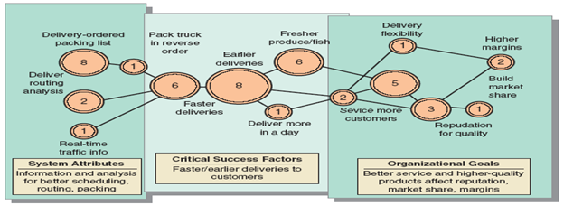
Critical success factors (CSFs)

Slide 41
Critical success factors (CSFs)
Examples of Critical Success Factors
1. Skills
The success of an organization depends on many factors and one of it is the human factors. In order to make sure that the organization can increased its competitiveness in regards to competitive environment, skills worker or employee is needed.
Papalexandris & Nikandrou (2000) in their study found out that there are four main categories of skills that are demanded by the organizations which are, technical skills, human skills and conceptual skills and one of the skills included in the technical area is project planning.
Titthasiri (2000), in her study shows that representatives from all constituencies are important to prioritize the IT/IS objectives

Slide 42
Critical success factors (CSFs)
2. Cooperation from other departments
For some organization, the information system planning is prepared for the department which the information system would like to be implemented.
In order to make sure that the information system could benefit to the other users in that organization, it should get a full cooperation from other departments in that organization so that the particular departments knows the process of other departments.

Slide 43
Critical success factors (CSFs)
3. Financial Investment evaluation
In order to succeed in information system planning, an investment towards the information system technology should be made same as the investment towards other assets such as building, machinery, equipment and others, where it should be evaluated based on the priorities.
Lincoln and Shorrock (1990) found that many successful strategic IS projects had bypassed the normal justification process used in the organization.

Slide 44
Critical success factors (CSFs)
4. Human Resource
Allocation of human resources in information system planning process should be made to make sure that it is not underestimated.
Underestimation of this resource could lead the organization to miss their target dates and budgets (Lederer & Gardiner, 1992).
The assertion is that the better human resource allocation in preparing IS planning, the more likely to succeed in information system planning.

Slide 45
Critical success factors (CSFs)
5. IT Infrastructure
In order to make sure that the implementation of the information system planning is a success, it is very crucial to prepare all the infrastructures needed in implementing the plan.
Without the infrastructure, the plan will remain a plan. The assumption is that the better the IT organizational infrastructure of the organization, the more likely it is to succeed in information system planning.

Slide 46
Critical success factors (CSFs)
6. Facilities
The facilities are also one of the important contents that should be considered in the SISP process.
According to Titthasiri (2000), in the process of IS planning, facilities strategy should be made available such as allocations of the locations, buildings, rooms, security and furniture.
The other hypothesis is that the better facilities of the organization to support the ISP, the more likely it will succeed in information system planning.

Slide 47
Critical success factors (CSFs)
7. IT Organizational Structure
IT organizational structure is also an important content in SISP process.
According to Titthasiri (2000), organizational structure is important to answer a question on what IT structure to be organized, how to develop policies and procedures, how to organize the IT planning team, and how many should be included in a team.
The above statement asserts that the better the IT organizational structure of the organization, the more likely it will succeed in information system planning.

Slide 48
Critical success factors (CSFs)
8. External Environment
The external environment such as changes in supplier trends, customer preferences, emerging technology, government legislation and competitors’ actions may influence strategic information system planning by making it more difficult ( Lederer and Mendelow, 1990; Ragunathan and Ragunathan, 1991).
The hypotheses that can be derived from the above statement is the better analysis on the external environment the more likely the organization will succeed in information system planning.

Slide 49
Critical success factors (CSFs)
9. Top management support
Basis for SISP are the business goals, which fall within the scope of top management. SISP is very expensive and has far-stretching consequences for the organization (strategic impact, all kinds of business functions are involved).
For successful SISP, it is necessary to have the support of the top management (Galliers, 1992). Failure to get support from top management will lead to failure of SISP.
Our last hypothesis is the better the top management support, the more likely it is to succeed in information system planning.

Slide 50
MODELS FOR COMPETITIVE ADVANTAGE
PORTER’S FIVE FORCES MODEL, VALUE CHAIN ANALYSIS

Slide 51
PORTER’S FIVE FORCES MODEL
It is an analysis tool that uses five industry forces to determine the intensity of competition in an industry and its profitability level.
Five forces model was created by M. Porter in 1979 to understand how five key competitive forces are affecting an industry. The five forces identified are:
The threat of entry of new competitors
The bargaining power of suppliers
The bargaining power of customers (buyers)
The threat of substitute products or services
The rivalry among existing firms in the industry.

Slide 52
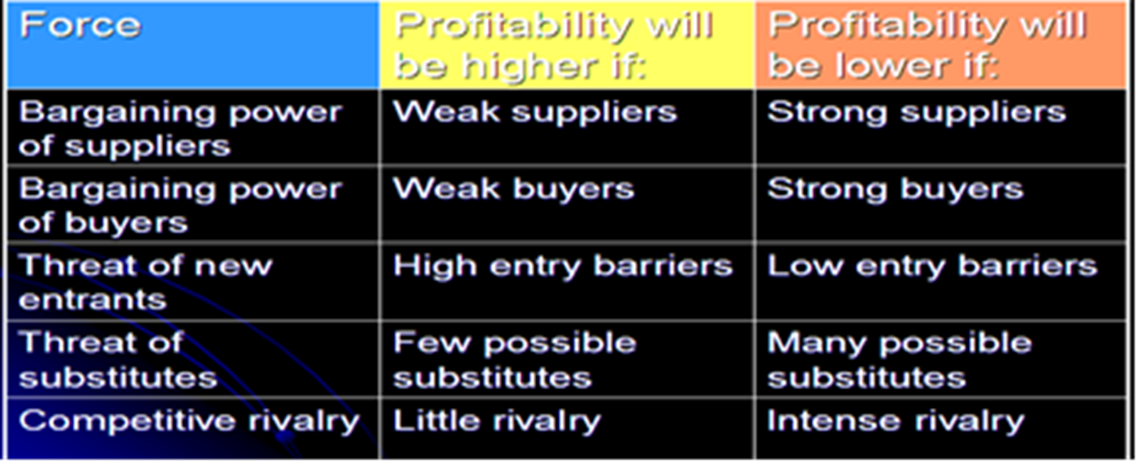
PORTER’S FIVE FORCES MODEL

Slide 53
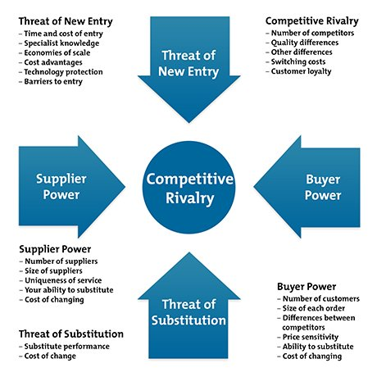
PORTER’S FIVE FORCES MODEL

Slide 54
PORTER’S FIVE FORCES MODEL
The strength of each force is determined by several factors.
These forces determine an industry structure and the level of competition in that industry. The stronger competitive forces in the industry are the less profitable it is. An industry with low barriers to enter, having few buyers and suppliers but many substitute products and competitors will be seen as very competitive and thus, not so attractive due to its low profitability.
It is every strategist’s job to evaluate company’s competitive position in the industry and to identify what strengths or weakness can be exploited to strengthen that position. The tool is very useful in formulating firm’s strategy as it reveals how powerful each of the five key forces is in a particular industry.

Slide 55
PORTER’S FIVE FORCES MODEL
Threat of new entrants
This force determines how easy (or not) it is to enter a particular industry. If an industry is profitable and there are few barriers to enter, rivalry soon intensifies. When more organizations compete for the same market share, profits start to fall. It is essential for existing organizations to create high barriers to enter to deter new entrants. Threat of new entrants is high when:
Low amount of capital is required to enter a market;
Existing companies can do little to retaliate;
Existing firms do not possess patents, trademarks or do not have established brand reputation;
There is no government regulation;
Customer switching costs are low (it doesn’t cost a lot of money for a firm to switch to other industries);
There is low customer loyalty;
Products are nearly identical;
Economies of scale can be easily achieved

Slide 56
PORTER’S FIVE FORCES MODEL
Bargaining power of suppliers
Strong bargaining power allows suppliers to sell higher priced or low quality raw materials to their buyers. This directly affects the buying firms’ profits because it has to pay more for materials. Suppliers have strong bargaining power when:
There are few suppliers but many buyers;
Suppliers are large and threaten to forward integrate;
Few substitute raw materials exist;
Suppliers hold scarce resources;
Cost of switching raw materials is especially high.

Slide 57
PORTER’S FIVE FORCES MODEL
Bargaining power of buyers
Buyers have the power to demand lower price or higher product quality from industry producers when their bargaining power is strong. Lower price means lower revenues for the producer, while higher quality products usually raise production costs. Both scenarios result in lower profits for producers. Buyers exert strong bargaining power when:
Buying in large quantities or control many access points to the final customer;
Only few buyers exist;
Switching costs to other supplier are low;
They threaten to backward integrate;
There are many substitutes;
Buyers are price sensitive.

Slide 58
PORTER’S FIVE FORCES MODEL
Threat of substitutes
This force is especially threatening when buyers can easily find substitute products with attractive prices or better quality and when buyers can switch from one product or service to another with little cost. For example, to switch from coffee to tea doesn’t cost anything, unlike switching from car to bicycle.

Slide 59
PORTER’S FIVE FORCES MODEL
Rivalry among existing competitors
This force is the major determinant on how competitive and profitable an industry is. In competitive industry, firms have to compete aggressively for a market share, which results in low profits. Rivalry among competitors is intense when:
There are many competitors;
Exit barriers are high;
Industry of growth is slow or negative;
Products are not differentiated and can be easily substituted;
Competitors are of equal size;
Low customer loyalty.

Slide 60
PORTER’S FIVE FORCES MODEL
Although, Porter originally introduced five forces affecting an industry, scholars have suggested including the sixth force: complements. Complements increase the demand of the primary product with which they are used, thus, increasing firm’s and industry’s profit potential. For example, iTunes was created to complement iPod and added value for both products. As a result, both iTunes and iPod sales increased, increasing Apple’s profits.

Slide 61
RESPONSE STRATEGIES
Cost leadership – producing products/services at the lowest cost in the industry
Differentiation – being unique in the industry
Focus – selecting a narrow-scope segment (niche market) and achieving either a cost leadership or differentiation
Additional strategies – emphasizing sustainability of strategic advantage, including strategic positioning, improved operational effectiveness (internal efficiency), and customer service.

Slide 62
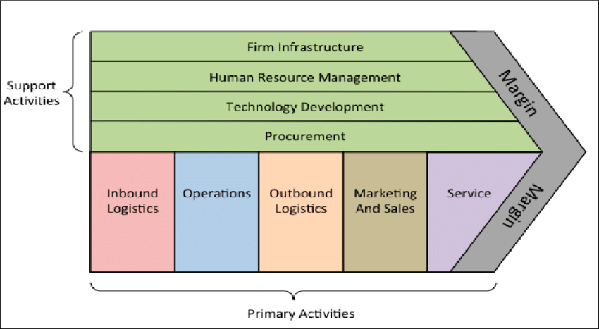
PORTER’S VALUE CHAIN ANALYSIS MODEL

Slide 63
PORTER’S VALUE CHAIN ANALYSIS MODEL
According to Porter, the activities conducted in any manufacturing organization can be divided into two parts:
Primary activities
Inbound logistics (inputs)
Operations (manufacturing and testing)
Outbound logistics (storage and distribution)
Marketing and sales
Service

Slide 64
PORTER’S VALUE CHAIN ANALYSIS MODEL
The primary activities are sequenced and work progresses in the order given while value is added at each stage
Incoming raw materials are processed (in receiving storage)
Materials are used in operations (more value is added) to make products.
Products are packaged for delivery (packaging, storing, and shipping)
Marketing and sales – delivering product to customers
After sales service is done for the customer.
NOTE: All the value-adding activities ultimately result in a profit.

Slide 65
PORTER’S VALUE CHAIN ANALYSIS MODEL
Support (secondary) activities
The primary activities are supported by the following support/secondary activities:
The company’s infrastructure (accounting, finance, mgt)
HRM
R&D (technology development)
Procurement.
Each support activity can support any or all of the primary activities.

Slide 66
PORTER’S VALUE CHAIN ANALYSIS MODEL
Porter’s Value System
A company’s value chain is a part of a larger stream of activities called a value system.
A value system includes both the suppliers that provide the inputs that form the raw materials, and their value chains.
Once the company creates products, they pass through the value chain of distributors with their own value chains; and finally to the consumers (buyers), who also have value chains of their own.
Thus gaining and sustaining a competitive advantage and supporting that advantage by using IT requires an understanding of this value system.
The value chain and the value system concepts can be applied to any organization, large and small, private and public.
The model was initially used to analyze an organization’s internal operations to increase its efficiency, effectiveness, and competitiveness; however, it was later used to as basis for explaining the support IT can provide.

